Slide 1
Electrical Lighting and Similar Equipment
EN 55015:2000+A1
Dop: 2001-05-01
Dow:2003-08-01

Slide 2
Electrical Lighting and Similar Equipment
Scope:
Excluded:
Lighting equipment operating in the ISM frequency bands;
Lighting equipment for aircraft and airport;
Apparatus equipment for the EMC requirements are formulated in other standards;
(e.g. build-in lighting devices in other equipment; photocopiers; slide projector;
lighting for road vehicles.)

Slide 3
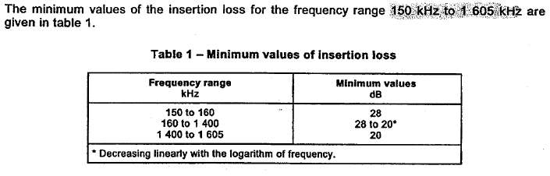
Electrical Lighting and Similar Equipment
Test items:
4.2 Insertion Loss:

Slide 4
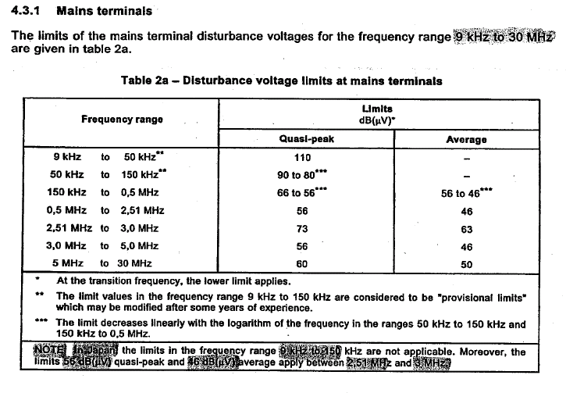
Electrical Lighting and Similar Equipment
Test items:
4.3 Disturbance voltage:

Slide 5
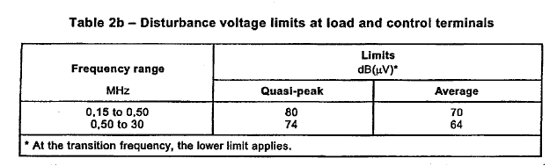
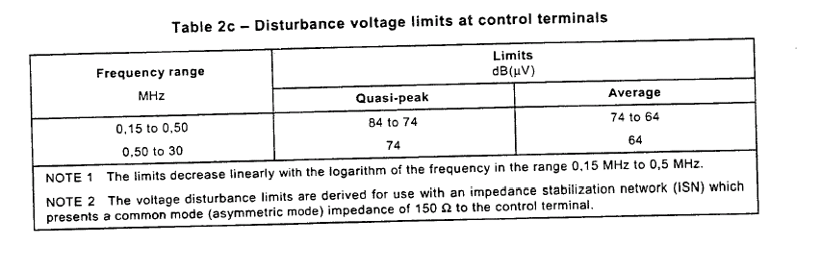
Electrical Lighting and Similar Equipment
Test items:
4.3.1 Disturbance voltage on load terminal:
4.3.2 Disturbance voltage on control terminal:

Slide 6
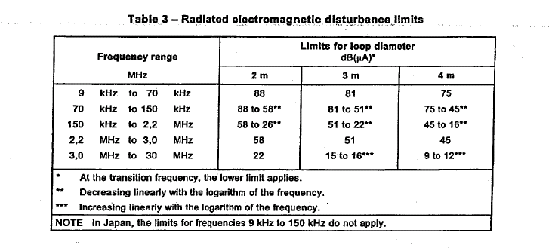
Electrical Lighting and Similar Equipment
Test items:
4.4 Radiated electromagnetic disturbances:

Slide 7
Electrical Lighting and Similar Equipment
5 Application of the limit:
5.1 General:
Application of the limit for various kinds of lighting equipment as
mentioned in the scope of this standard are given in 5.2 to 5.10;
No emission requirements apply to lamps other than self-ballasted lamps
nor to anxiliaries incorporated in luminaires, in self-ballasted lamps or in
semi-luminaires.
Disturbance caused by manual or automatic operation will be disregarded.
(switch which will be repeatedly operated(advertising signs) are excluded.)

Slide 8
Electrical Lighting and Similar Equipment
5.2 Indoor luminaires:
Incandescent lamp luminaires;
Fluorescent lamp luminaires; (insertion loss)
Other luminaires;
1) comply with the mains terminal---table 2a;
2) luminaire with the operation frequency excess of 100Hz---table 3;
3) regulated by the external device---table 2b;

Slide 9
Electrical Lighting and Similar Equipment
5.3 Independent auxiliaries exclusively for use with lighting equipment
(device being applied to external to a luminaire e.g.: dimmer, transformer, convertors)
Types of device (independent directly operating lighting regulating devices
and independent remote control devices.
Independent transformers and convertors for incandescend lamps
Independent ballasts for fluorescent and other discharge lamps
Semi-luminaires
Independent starters and igniters

Slide 10
Electrical Lighting and Similar Equipment
5.4 Self-ballasted lamps
5.5 Outdoor lighting appliances
5.6 UV and IR radiation appliances
5.7 Transport Lighting
5.8 Neon and other advertising signs
5.9 Self-contained emergency lighting luminaires
5.10 Replaceable starter for fluorescent lamps

Slide 11
Electrical Lighting and Similar Equipment
6 Operating conditions for lighting equipment
General
Lighting equipment
Supply voltage and frequency
Ambient conditions
Lamps
Replaceable starter

Slide 12
Electrical Lighting and Similar Equipment
7 Method of insertion loss measurement
Circuits for the measurement of insertion loss;
Measuring arrangement and procedure
Luminaire
Measurement procedure

Slide 13
Electrical Lighting and Similar Equipment
8 Method of measurement of disturbance voltages
Measuring arrangement and procedure
Indoor and outdoor luminaire
Independent light regulating devices
Independent ballasts for fluorescent and other discharge lamps
Self-ballast lamps and semi-luminaire
UV and IR radiation appliances
Self-contained emergency lighting luminaires
Independent starter and igniters for fluorescent and other
discharge lamps

Slide 14
Electrical Lighting and Similar Equipment
9 Method of measurement of radiated electromagnetic disturbances

Slide 15
Electrical Lighting and Similar Equipment

